Slide 1
IoT Multi-Intersection
Traffic Light System
CEIS114 – Final Course Project
DeVry University | College of Engineering and Information Sciences
Modules 2 – 7 | Week 8 Submission

Slide 2
Introduction
Project Overview
Project Progression
Course: CEIS114 – IoT Fundamentals
Goal:
Design and simulate a smart, IoT-connected multi-intersection traffic light system using an ESP32 microcontroller and the Wokwi cloud simulator.
Platform:
Wokwi.com — browser-based circuit and code simulator
Controller:
ESP32 microcontroller with Arduino-style C++ code
Mod 2
ESP32 & Wokwi Setup / WiFi Scan
Mod 3
Single Traffic Light Controller
Mod 4
Multi-Intersection Controller
Mod 5
Add Pedestrian Crosswalk Button
Mod 6
Add Buzzer & LCD Display
Mod 7
IoT Control via MQTT / Emergency Mode

Slide 3
Project Walk-Through
Module 2 – Wokwi Setup
Module 3 – Single Traffic Light
Module 4 – Dual Intersection
Registered on Wokwi, set up the ESP32 template, added a breadboard, and ran a WiFi network scan to confirm microcontroller connectivity.
Wired 3 LEDs (Red/Yellow/Green) to GPIO 14/12/13. Programmed a repeating loop: RED 2 s → GREEN 2 s → YELLOW 2 s using digitalWrite().
Added a second set of LEDs (GPIO 25/26/27). Coded alternating N-S and E-W light patterns with interleaved timing for realistic intersection control.
Module 5 – Crosswalk
Module 6 – Buzzer & LCD
Module 7 – IoT / Emergency
Added a pushbutton (GPIO 19). When pressed, all lights go RED and the Serial Monitor counts down from 10 to 0 with a 'Walk / Do Not Walk' message.
Integrated a 16×2 I²C LCD (LiquidCrystal_I2C library) and a buzzer (GPIO 32). LCD displays 'Walk' countdown and 'Do Not Walk'; buzzer beeps during crossing.
Added MQTT via PubSubClient + WiFi. A blue emergency LED (GPIO 16) flashes and all lights go RED when 'Emergency ON' is published via the IoT MQTT Panel app.

Slide 4
Challenges
01
GPIO Pin Conflicts
Managing multiple components across limited ESP32 GPIO pins — LEDs, button, buzzer, LCD (I²C SDA/SCL), and blue emergency LED — required careful pin mapping to avoid conflicts.
02
LCD I²C Address
The LiquidCrystal_I2C library requires the correct I²C address (0x27 or 0x3F). Mismatches caused a blank display requiring troubleshooting with address scanner code.
03
Crosswalk Timing & Debounce
The Module 7 crosswalk used hardware interrupts with a 20 ms debounce filter to prevent button bounce from triggering multiple crossing events unintentionally.
04
MQTT Connectivity
Connecting to the public test.mosquitto.org broker in Wokwi required understanding WiFi STA mode, client IDs, topic subscriptions, and callback-based message handling.
05
Real-Time IoT Responsiveness
Ensuring the system could break out of traffic light loops when an MQTT Emergency ON message arrived required inserting client.loop() checks and break statements throughout.

Slide 5
Career Skills Developed
Embedded Programming
IoT & Networking
Arduino C++ on ESP32
GPIO pin control & management
Hardware interrupt handling
Library integration (I²C, MQTT, WiFi)
MQTT publish/subscribe protocol
WiFi STA mode & connection management
Cloud broker connectivity (test.mosquitto.org)
Real-time remote device control
Circuit Design
Engineering Problem-Solving
Breadboard wiring & component layout
LED, buzzer, LCD, button integration
Ohm's law and resistor selection
Multi-component circuit debugging
Iterative design across 6 modules
Systematic debugging in simulation
Timing logic for real-world systems
Technical documentation & presentation

Slide 6
Conclusion
This project provided hands-on experience building a complete IoT system from the ground up — from a single blinking LED to a remotely controlled, multi-intersection traffic light with LCD feedback, audio alerts, and emergency override.
Gained practical ESP32 programming skills using Arduino C++
Designed and simulated multi-component IoT circuits in Wokwi
Implemented MQTT protocol for real-time remote device control
Applied iterative engineering design across six progressive modules
Developed troubleshooting skills for real-world embedded systems
Summary
DeVry University | CEIS114 | Week 8 Final Submission

Slide 7
References
Espressif Systems. (2024). ESP32 technical reference manual. https://www.espressif.com/en/products/socs/esp32
Wokwi. (2024). Wokwi – online Arduino & ESP32 simulator. https://wokwi.com
Knolleary. (2024). PubSubClient – MQTT library for Arduino. https://pubsubclient.knolleary.net
Mosquitto. (2024). Eclipse Mosquitto: An open source MQTT broker. https://mosquitto.org
Arduino. (2024). Arduino language reference. https://www.arduino.cc/reference/en
Marco Schwartz. (2016). Internet of Things with Arduino Blueprints. Packt Publishing.
IoT MQTT Panel. (2024). IoT MQTT Panel app documentation. https://snrlab.in/iotmqttpanel
DeVry University. (2024). CEIS114 Course Project Guides – Modules 2–7. Course Materials.

Slide 8
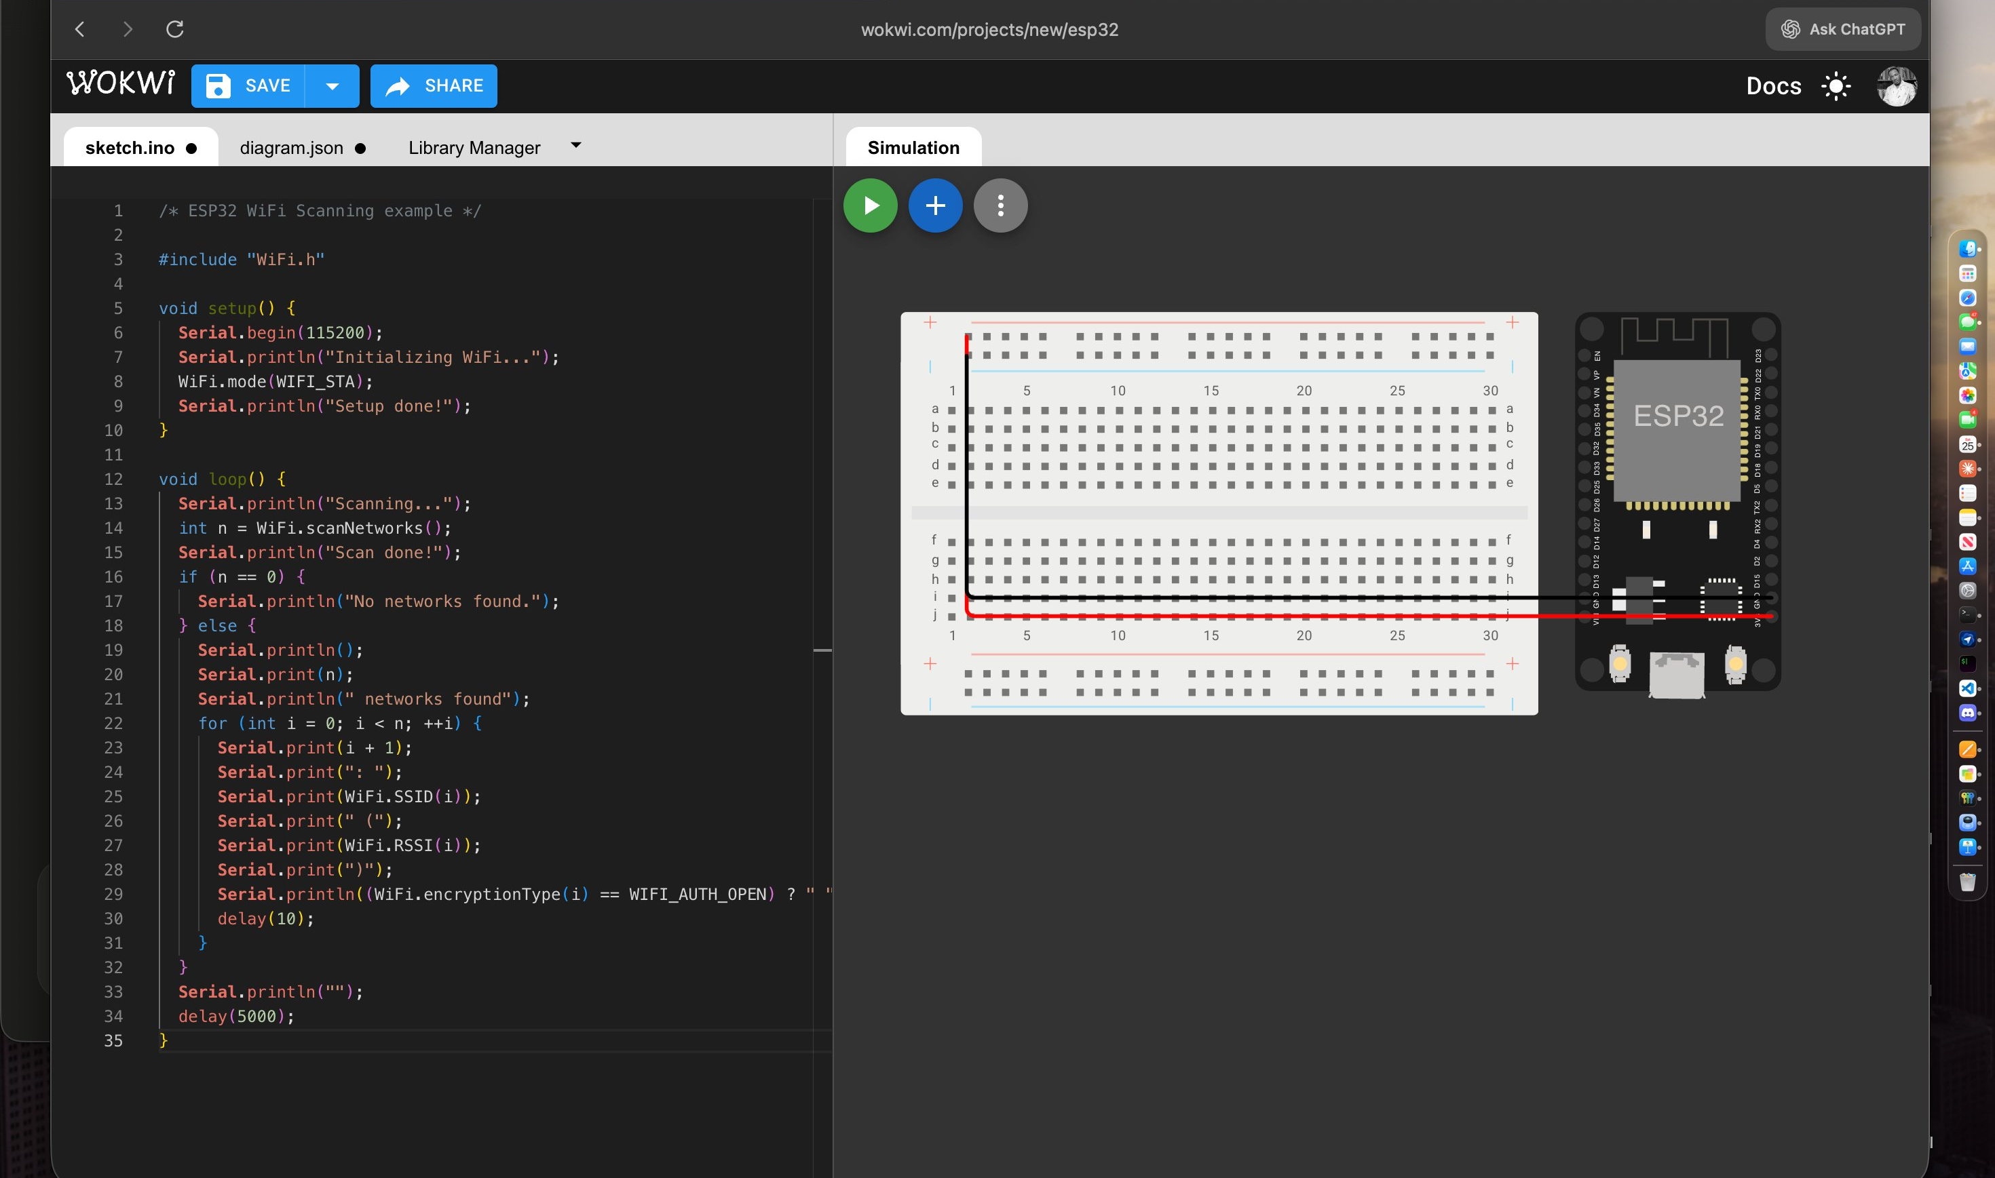
Module 2 – ESP32 WiFi Scan Screenshots
Figure 1 – Code & Circuit (sketch.ino + Simulation)
Figure 2 – ESP32 WiFi Scan (Code + Breadboard)
Module 2 – ESP32 & Wokwi Setup | WiFi Network Scan Simulation

Slide 9
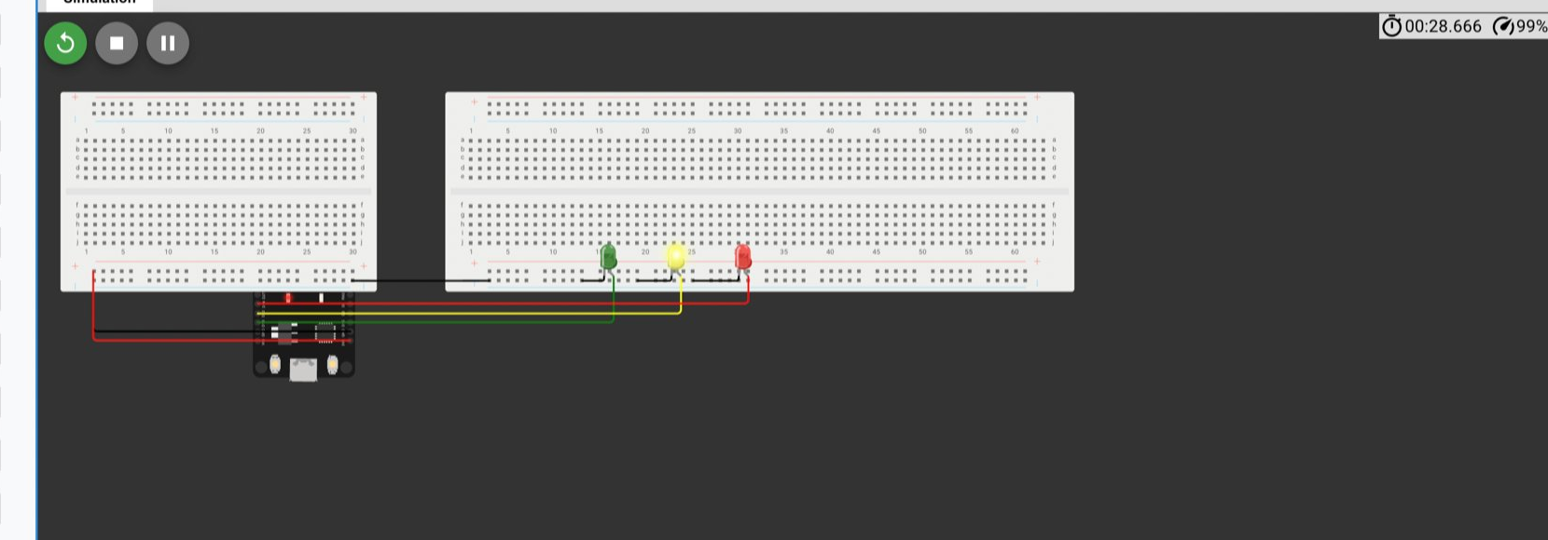
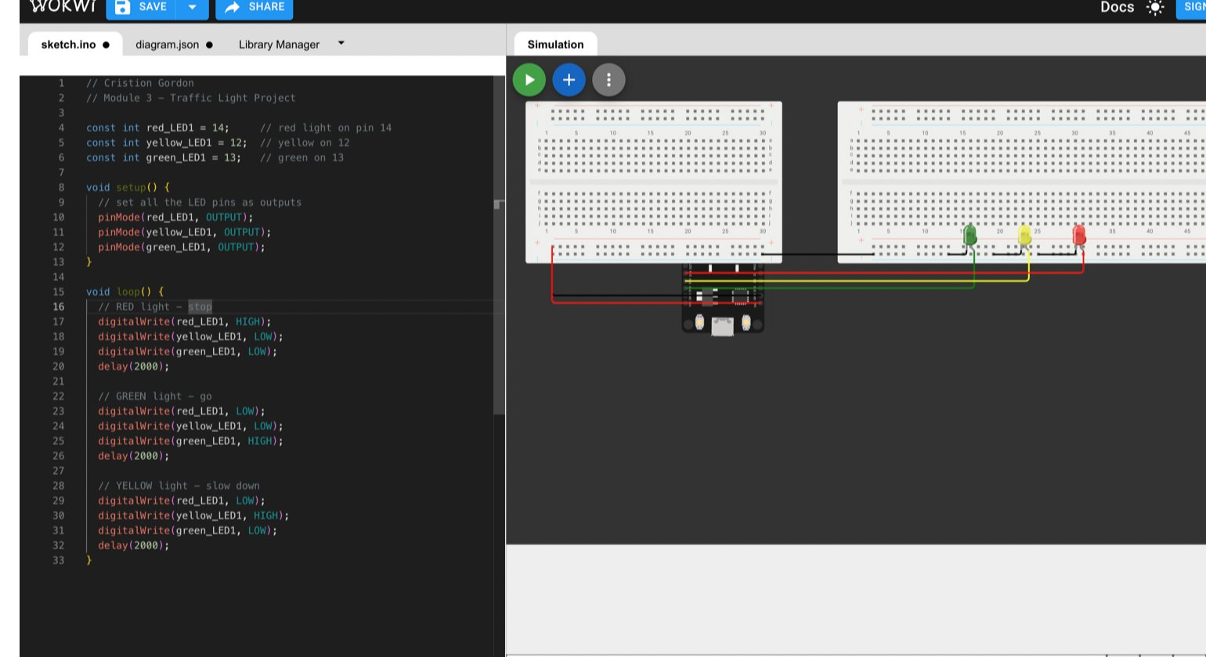
Module 3 – Wokwi Simulation Screenshots
Circuit Simulation
Code & Simulation
Module 3 – Single Traffic Light Controller | Wokwi ESP32 Simulation

Slide 10
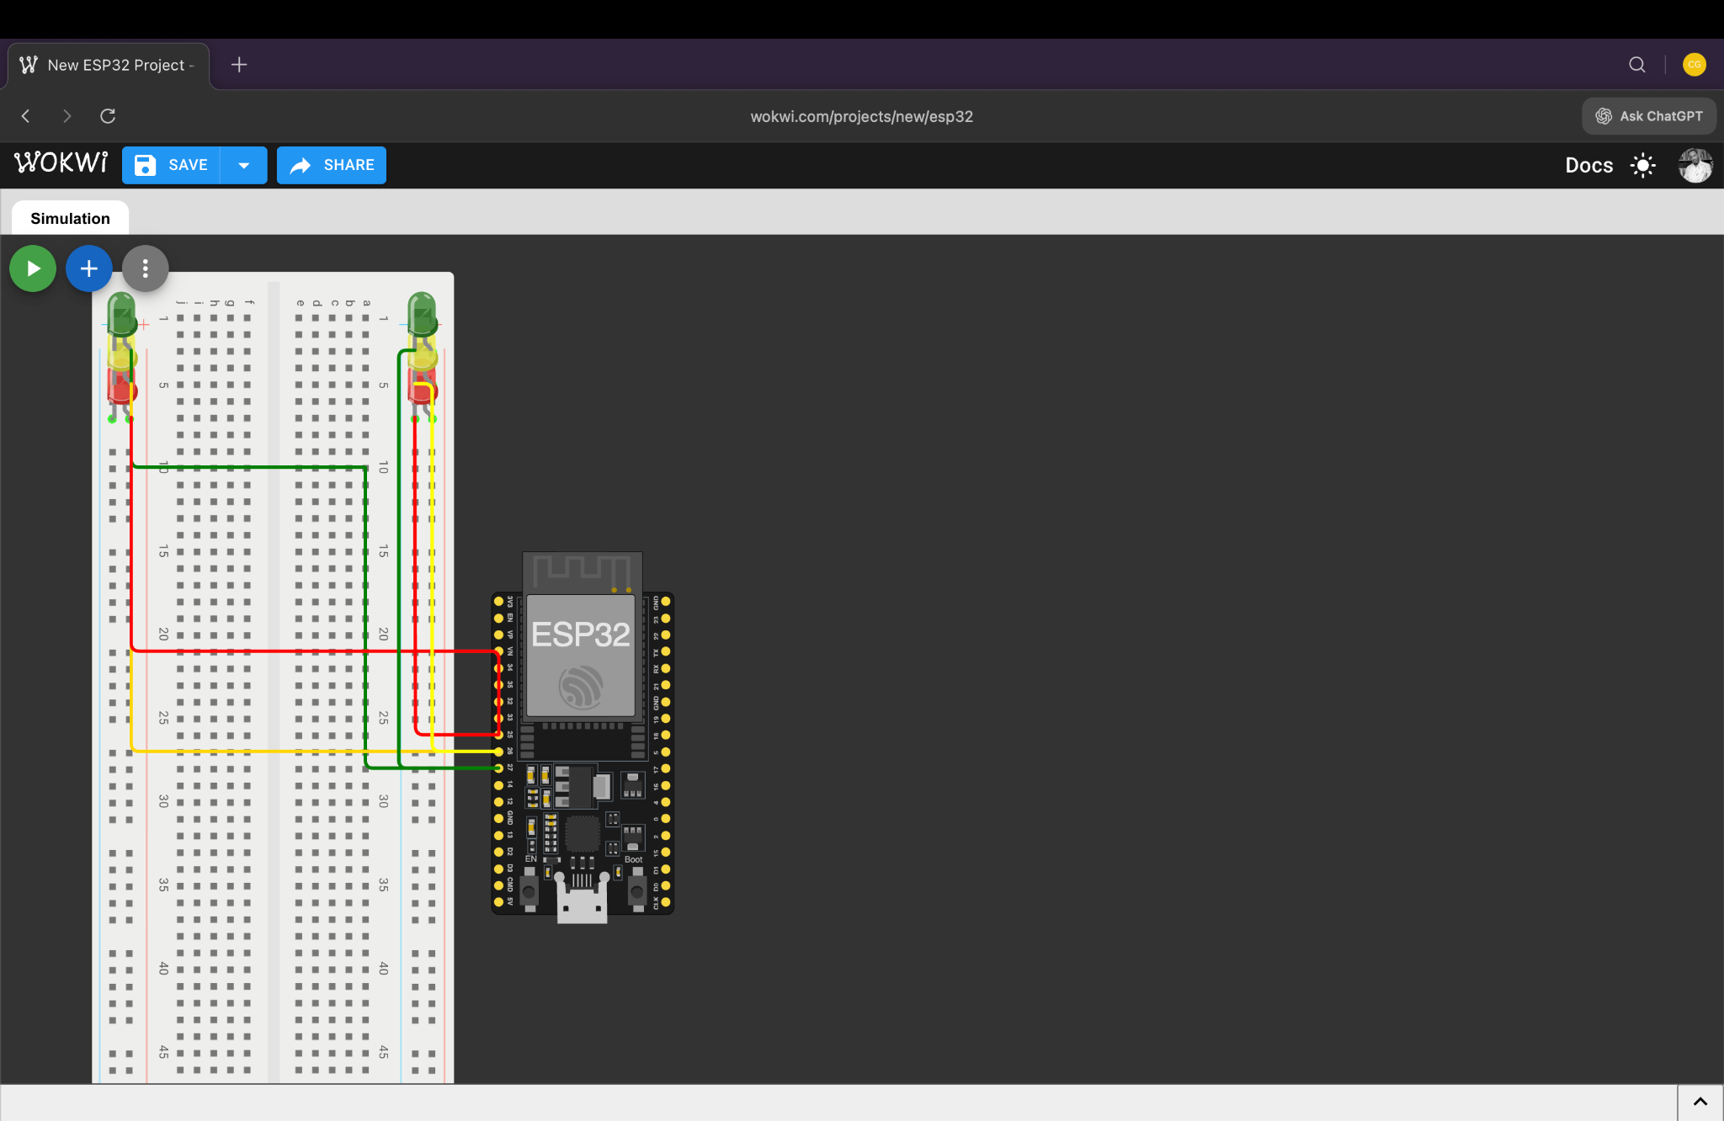
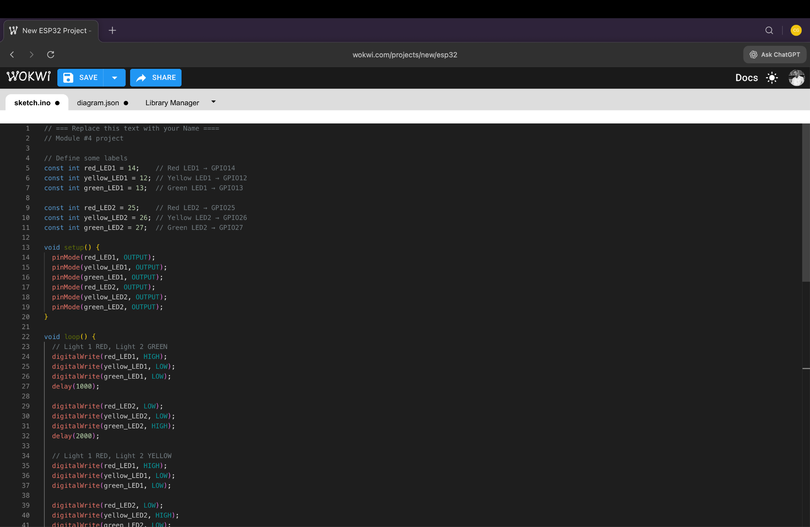
Module 4 – Dual Intersection Simulation Screenshots
Figure 1 – Circuit Simulation
Figure 2 – Code (sketch.ino)
Module 4 – Multi-Intersection Traffic Light Controller | Wokwi ESP32 Simulation

Slide 11
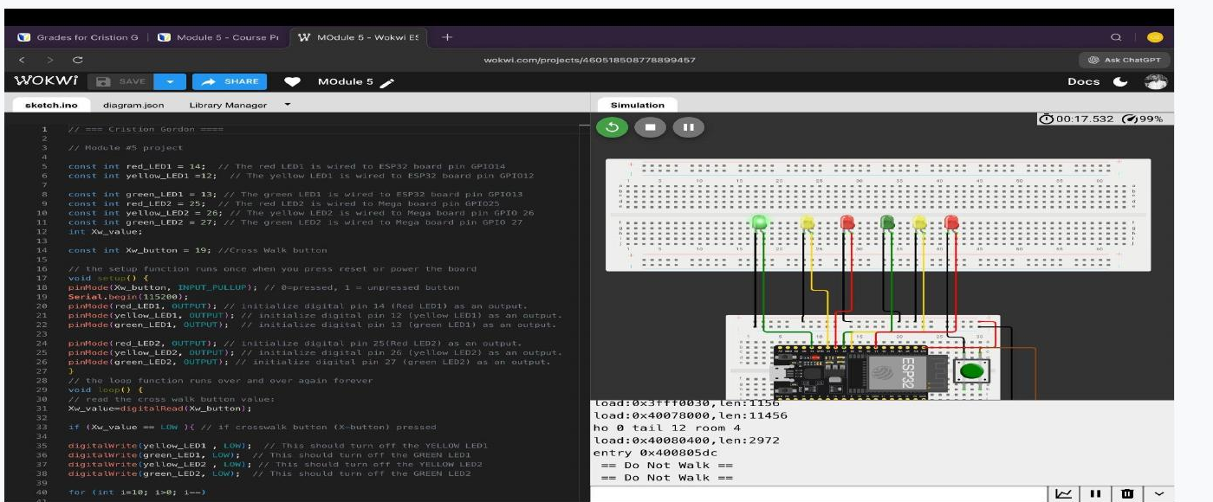
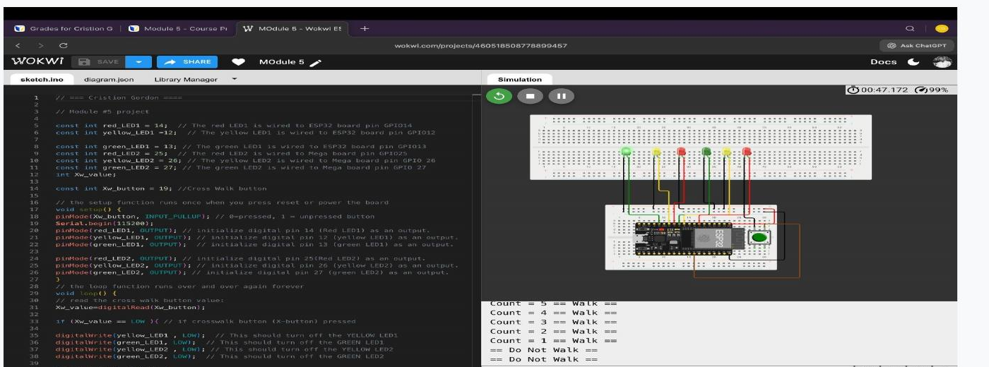
Module 5 – Crosswalk Simulation Screenshots
Figure 1 – Circuit Simulation
Figure 2 – Code & Serial Monitor
Module 5 – Multiple Traffic Light Controller with Pedestrian Crosswalk

Slide 12
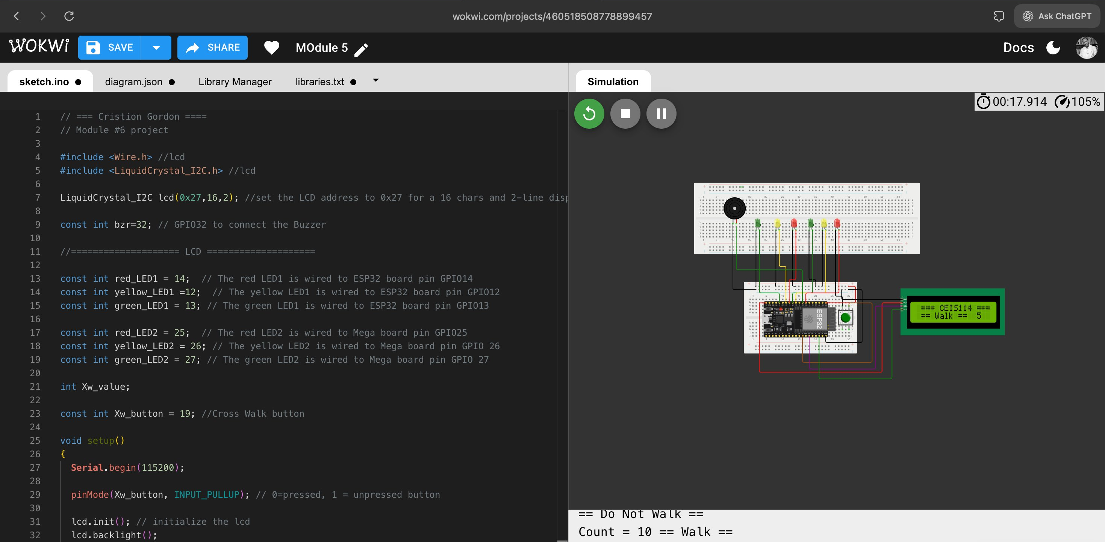

Module 6 – Buzzer & LCD Simulation Screenshots
Figure 1 – Code & LCD Simulation
Figure 2 – LCD Walk Countdown
Module 6 – Multiple Traffic Light Controller with Crosswalk, Buzzer & LCD

Slide 13
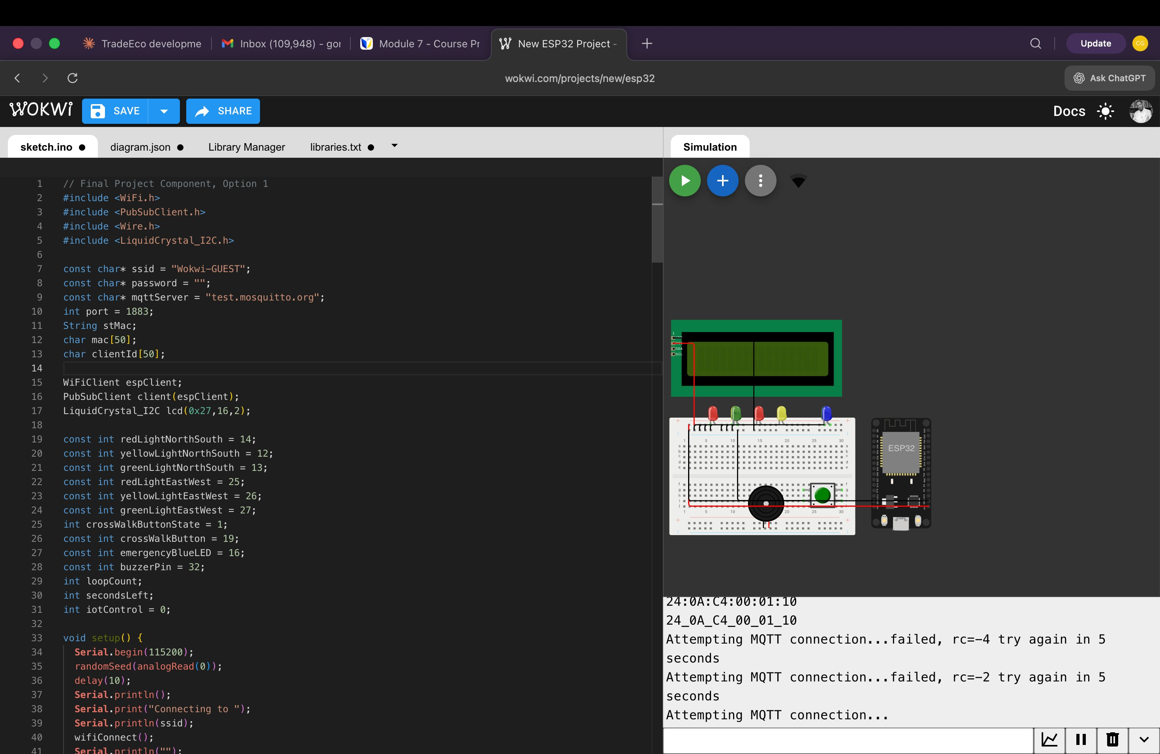
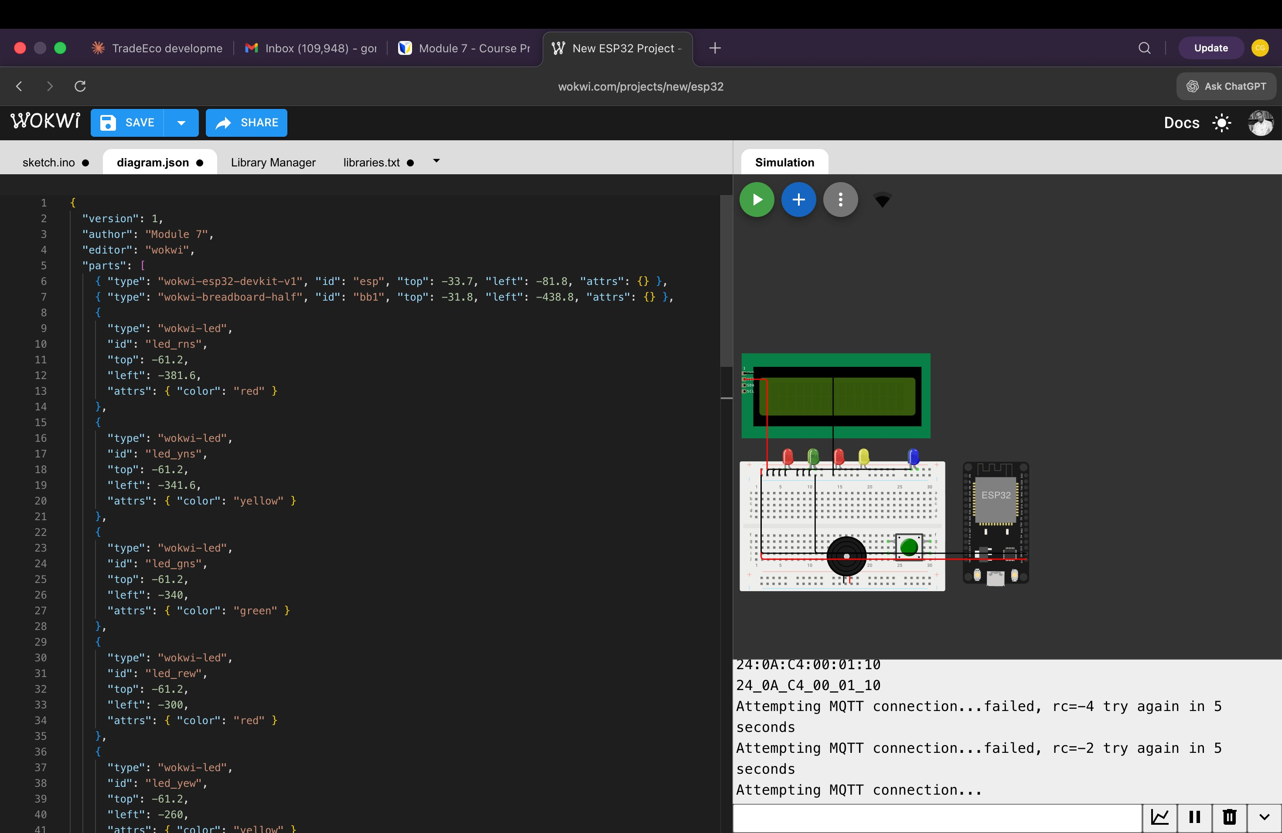
Module 7 – IoT MQTT Simulation Screenshots
Figure 1 – Code (sketch.ino)
Figure 2 – Circuit & Serial Monitor
Module 7 – IoT Multi-Intersection Traffic Light with MQTT Emergency Control

